Slide 1

A Presentation on Controlling mobile Robot using Bluetooth
Regenbogen
By
Pritish Samant
Manoj Luitel
Saikot Das Joy

Slide 2
Smartphone Controlled Robot
Locomotion
Communication and Control
Networking
Hardware
Decision and Actions
Simulation
Usability Domain

Slide 3
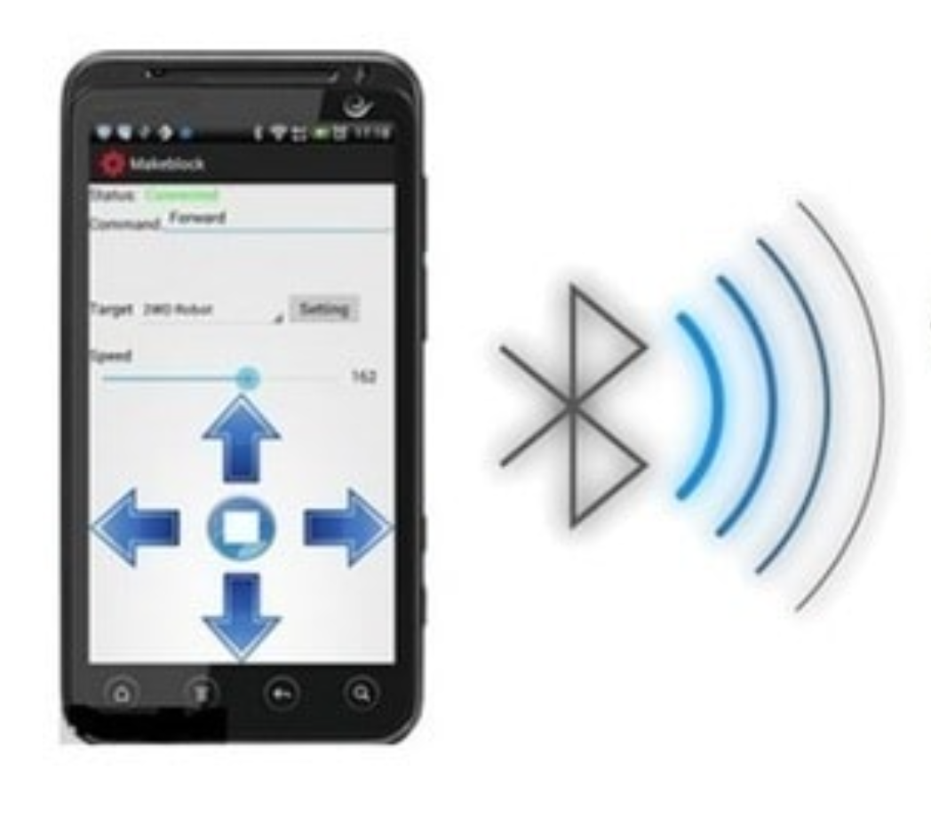
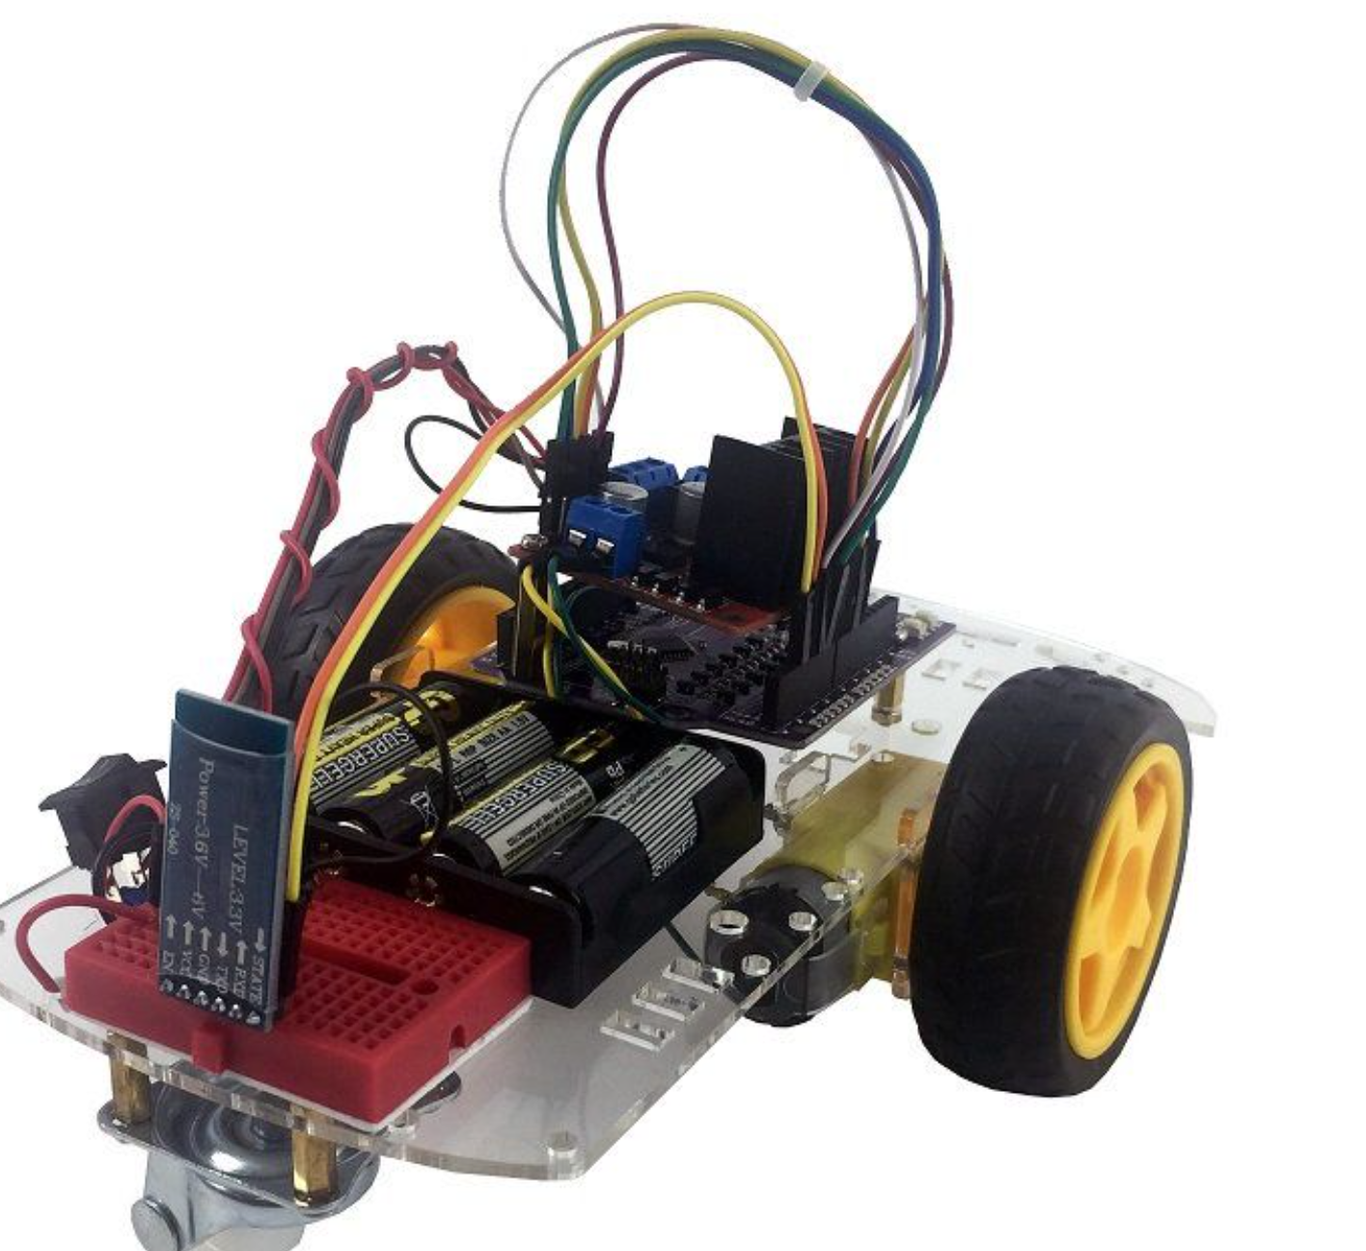
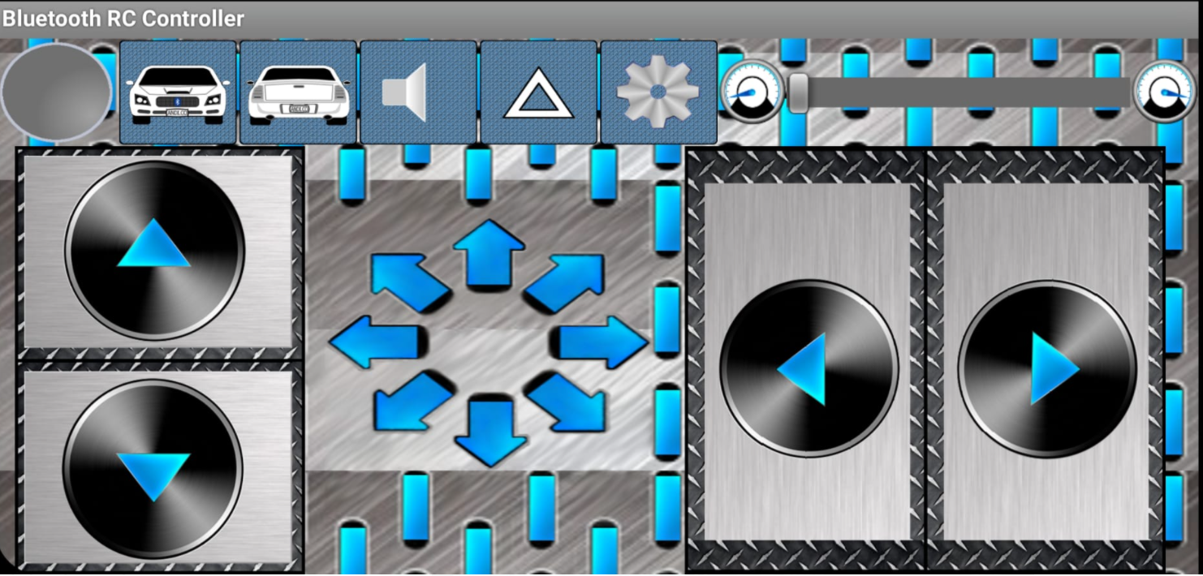
Overview
https://www.skyfilabs.com/project-ideas/bluetooth-controlled-robot
controlling mobile robot using using bluetooth - Bing images

Slide 4
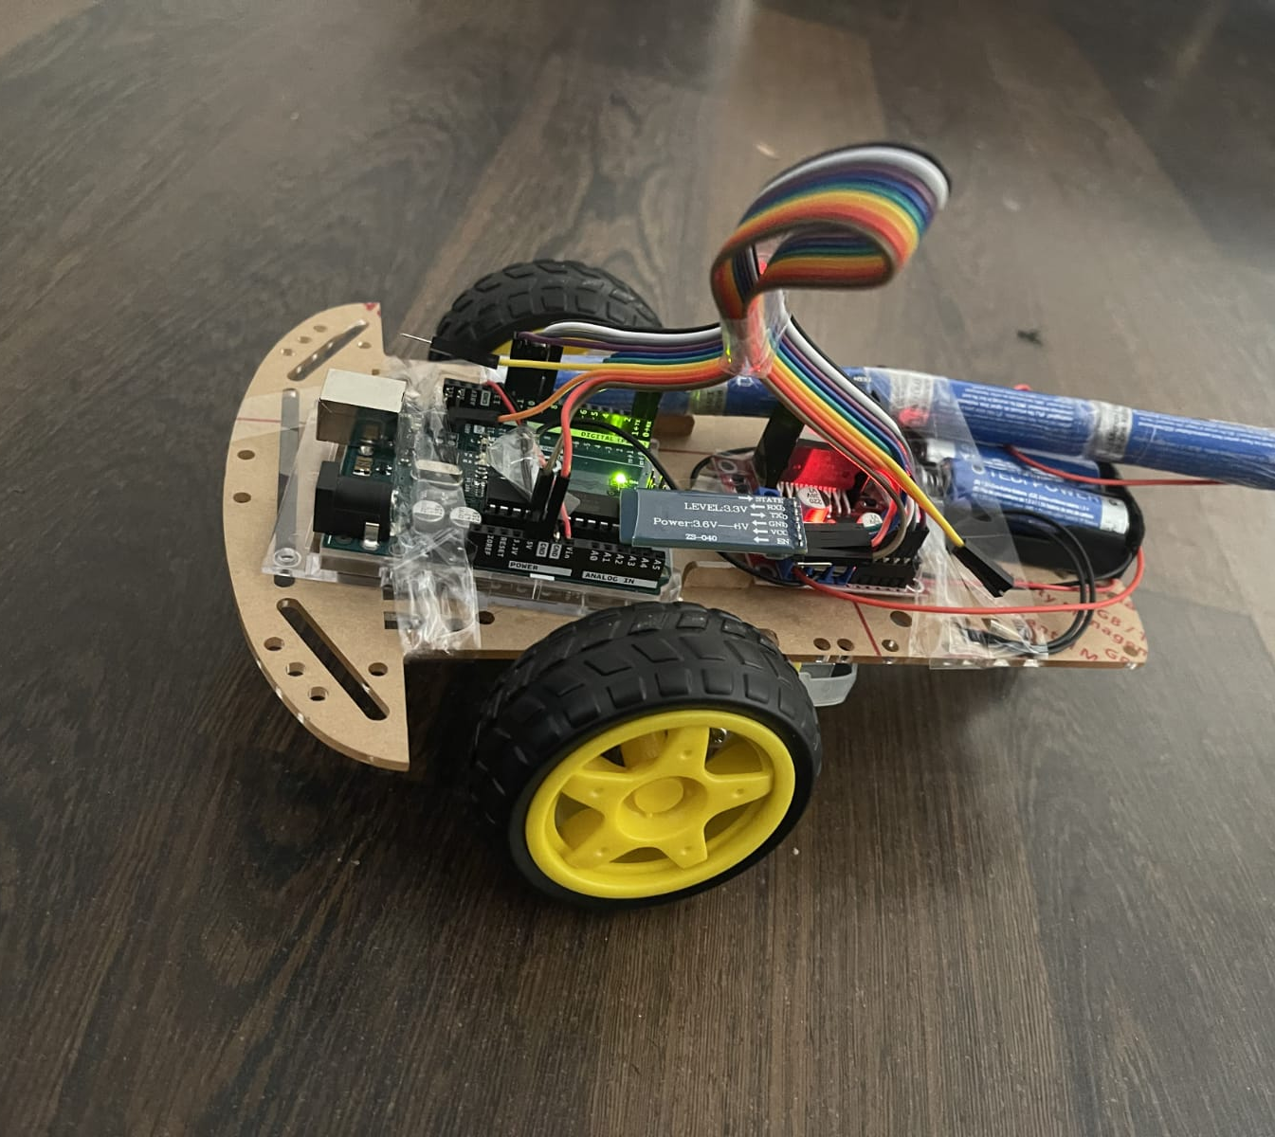
OUR PROTOTYPE

Slide 5
Locomotion
Range: Ideally 10-100m between Transmitter and Receiver
Movement mechanics : Motor Wheels

Slide 6
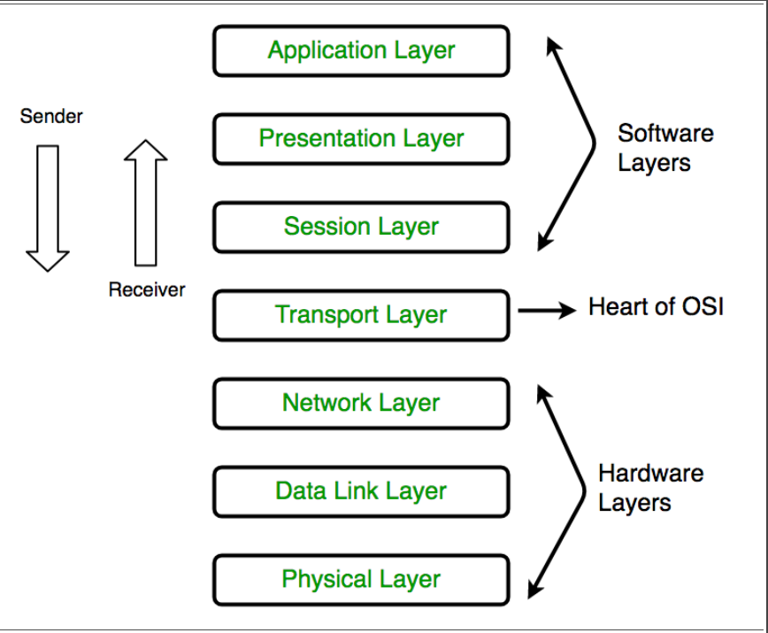
OSI Architecture for communication between two devices
The application layer, Presentation layer, and Session layer constitute the Software layer or upper layer.
The transport layer is called the heart of OSI.
. The network layer, Data link layer, and physical layer constitute the hardware layers or lower layers.

Slide 7
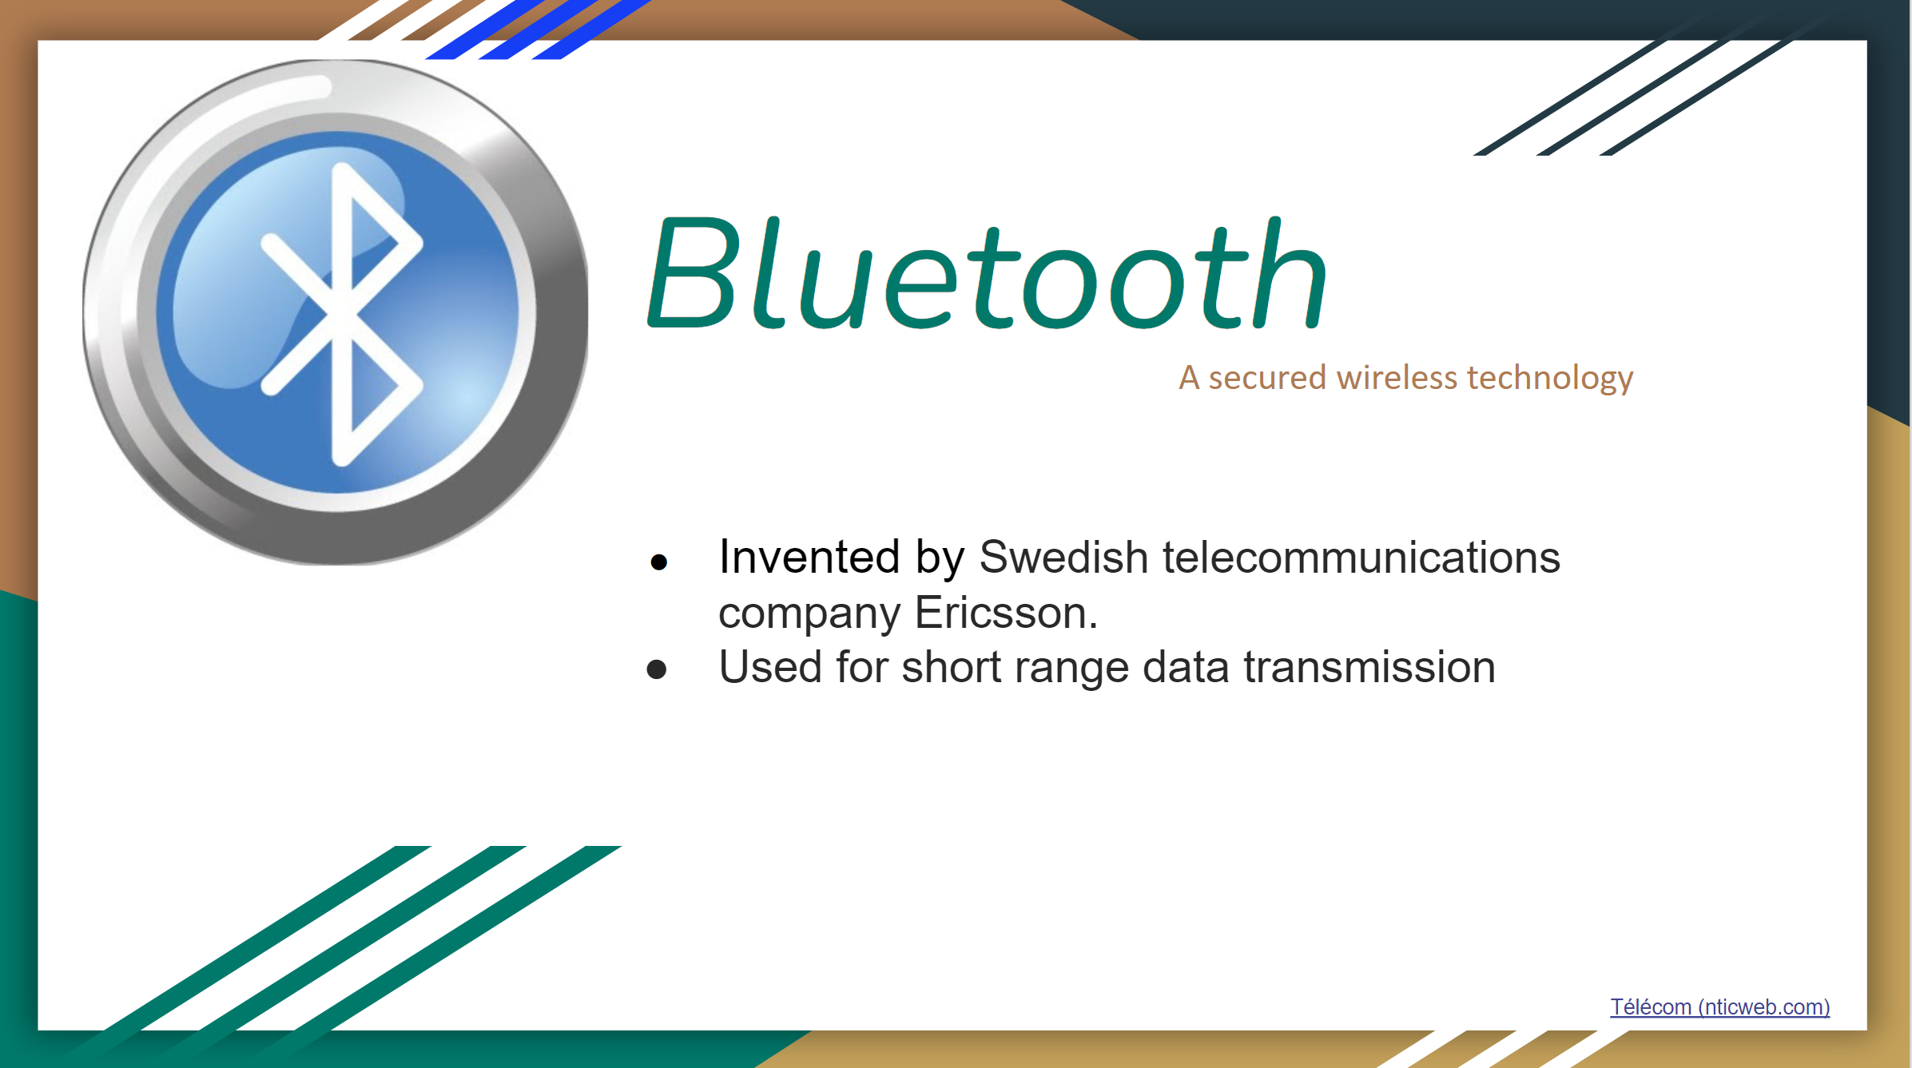

Slide 8
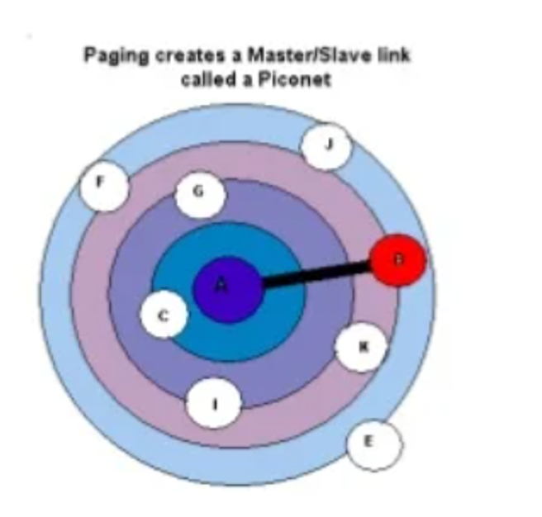
Communication Principle:
based upon Master/slave operation mode.
One device creates a network which is named as ‘’Piconet’’. All other devices are found within this range.

Slide 9
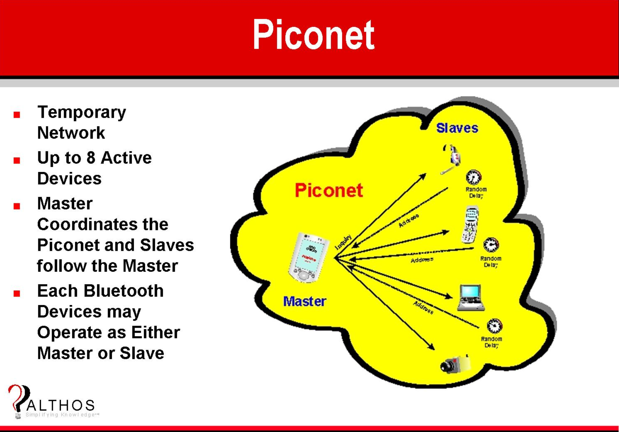
http://www.althos.com/tutorial/Bluetooth-tutorial-Piconet.html

Slide 10
Bluetooth Technology
Advantages
Wireless technology
No setup required
Industrial support available
Less power consumption
Disadvantages
Small range
Small data rate of 1 mbps
For personal use

Slide 11
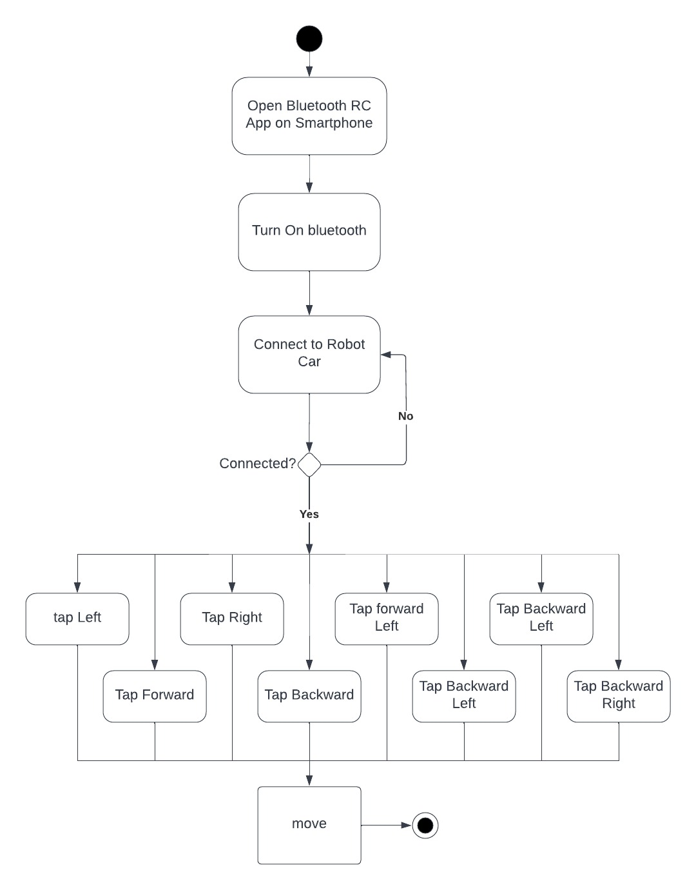
ACTIVITY DIAGRAM

Slide 12
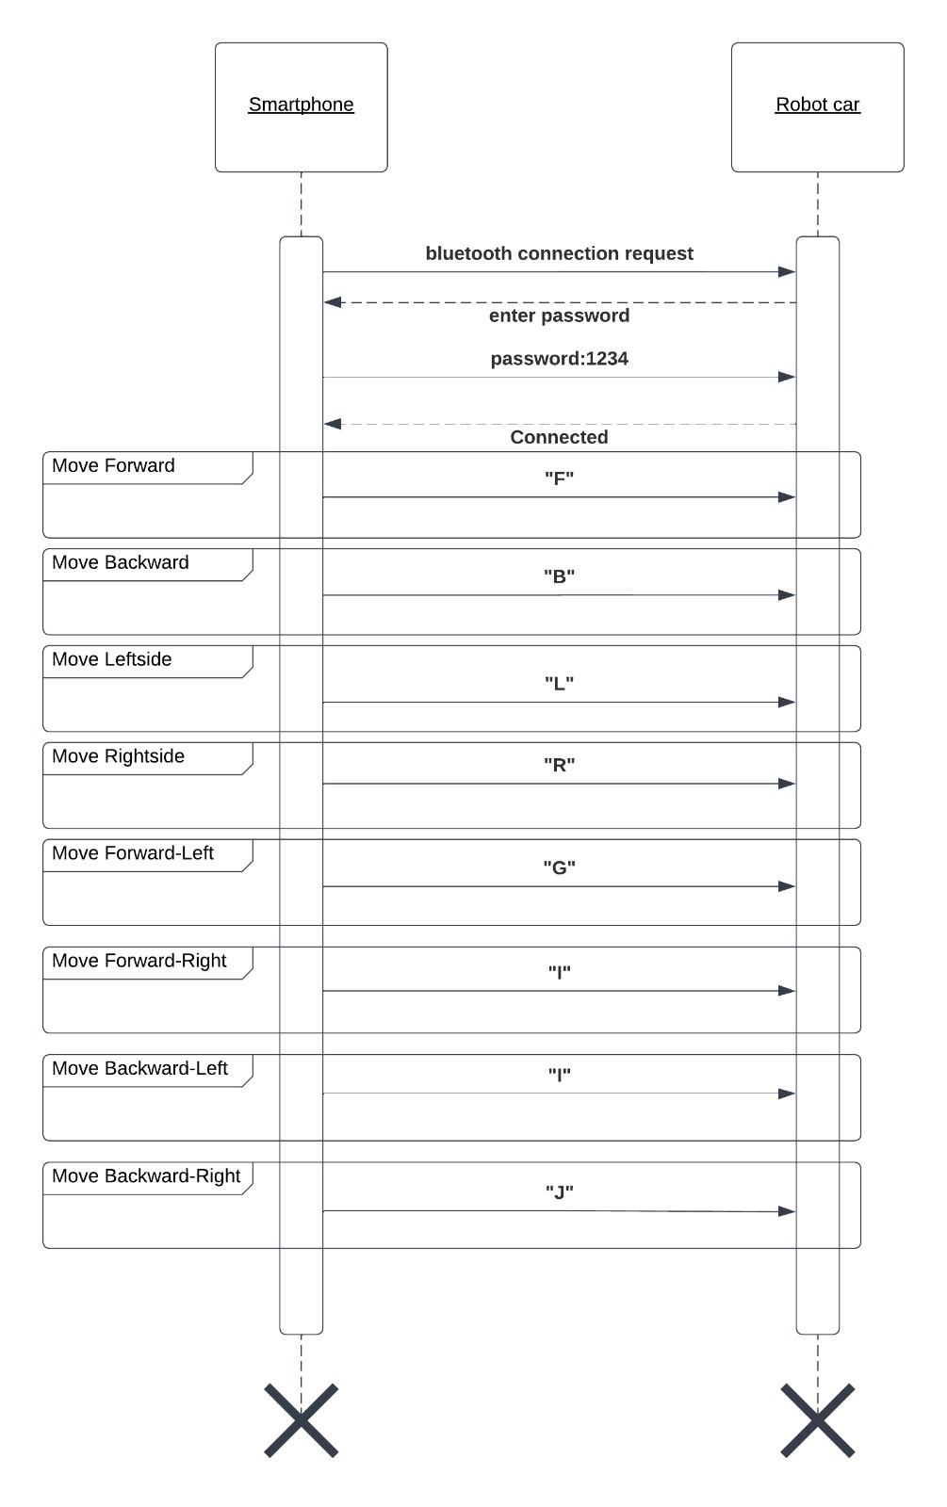
SEQUENCE DIAGRAM

Slide 13
Controlling robot car movement by smartphone
Connection is based on bluetooth technology Hardware Requirements:
Hardware requirements
Arduino Uno R3+Cable for Arduino UNO
DC 3-6V BO Gear motor with plastic tire wheel
HC 05 Bluetooth wireless UART module
L298N motor driver Module for Arduino
Three 4V dc battery
Software Requirements:
Bluetooth RC car app
Arduino

Slide 14
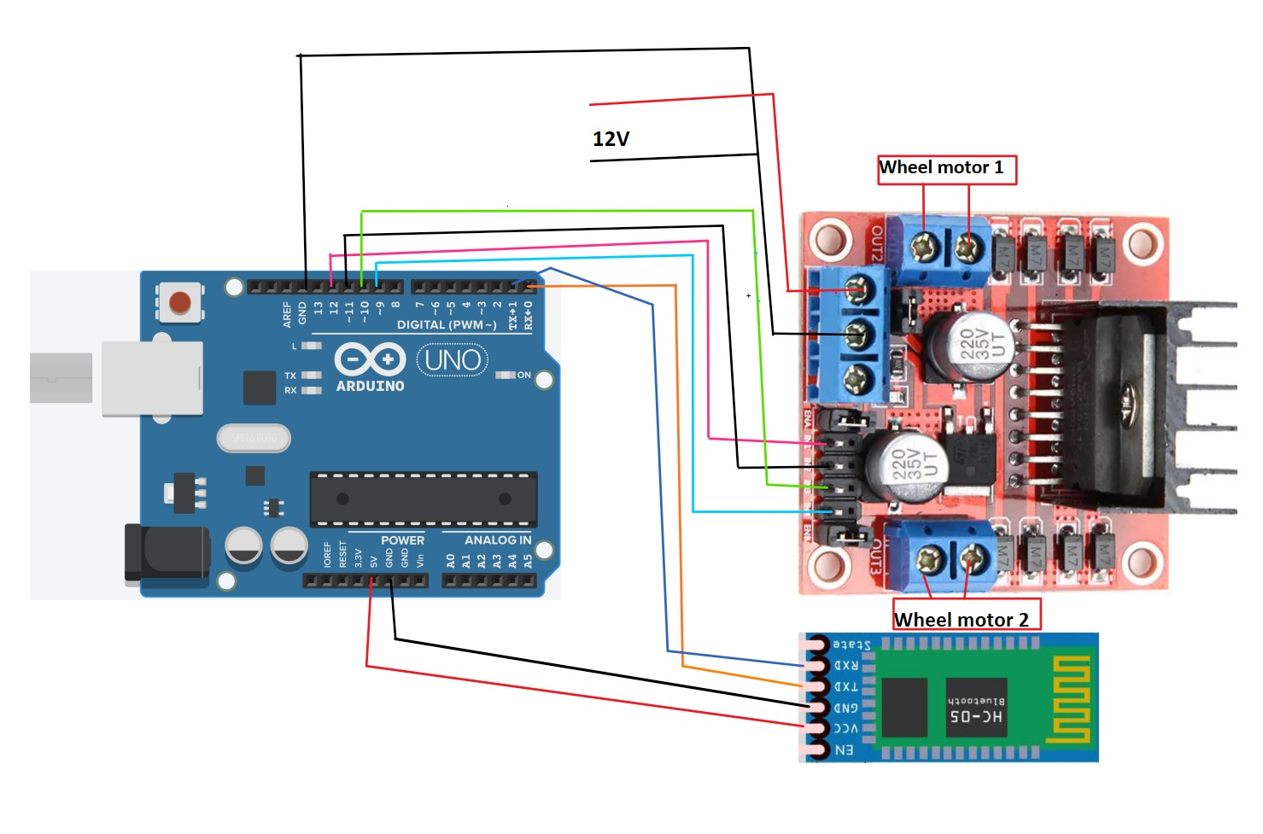
Circuit
fig. circuit

Slide 15
Bluetooth RC Controller android app
fig. app interface

Slide 16
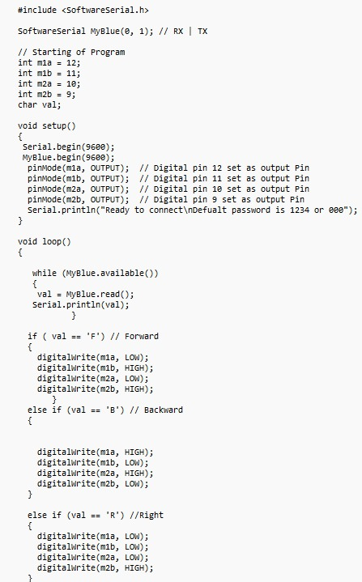
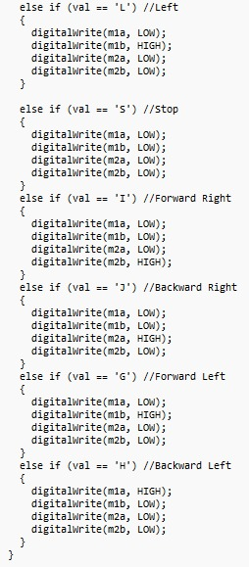
Arduino Code

Slide 17
References
[1] Y. Yi, F. Mengyin, S. Changsheng, W. Meiling and Z. Cheng, ”Control Law Design of Mobile Robot Trajectory Tracking and Development of Simulation Platform,” 2007 Chinese Control Conference, 2007, pp. 198- 202, doi: 10.1109/CHICC.2006.4347355. [2] Yeon-Gyun Kim, Dong Hun Kim, Hua Wang and Huosheng Hu, ”Smartphone-controlled user calling system for a mobile robot,” IEEE ISR 2013, 2013, pp. 1-6, doi: 10.1109/ISR.2013.6695642. [3] Lixin Tang and S. Yuta, ”Vision based navigation for mobile robots in indoor environment by teaching and playing-back scheme,” Pro- ceedings 2001 ICRA. IEEE International Conference on Robotics and Automation (Cat. No.01CH37164), 2001, pp. 3072-3077 vol.3, doi: 10.1109/ROBOT.2001.933089. [4] Saxena, P. OSI Reference Model – A Seven Layered Architecture of OSI Model. https://doi.org/10 November 2014 [5] Saxena, P. OSI Reference Model – A Seven Layered Architecture of OSI Model. https://doi.org/10 November 2014 [6] Layers of OSI Model - GeeksforGeeks. (2022, January 12). Retrieved May 1, 2022, from https://www.geeksforgeeks.org/layers-of-osi-model/

Slide 18
Thank you for watching!!
Questions?

